Slide 1
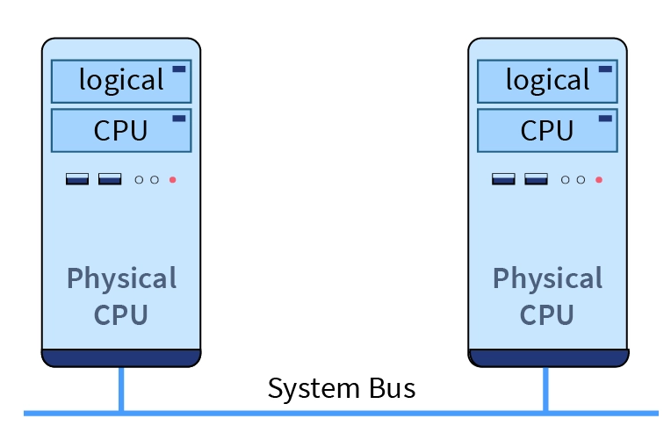
Multiprocessor Scheduling &
HU’s Algorithm
Abdullah Al Forkan
Matriculation Number: 2190314
University of Applied Sciences Hamm-Lippstadt
29.07.24 < <number> >

Slide 2
Motivation
Challenges:
Complex Problems
Larger Dataset
Slow Processors
Parallel Programming
Factors:
Powerful Processor
System Performance
Task Dependencies
Optimal
Short Time
University of Applied Sciences Hamm-Lippstadt
29.07.24 < <number> >

Slide 3
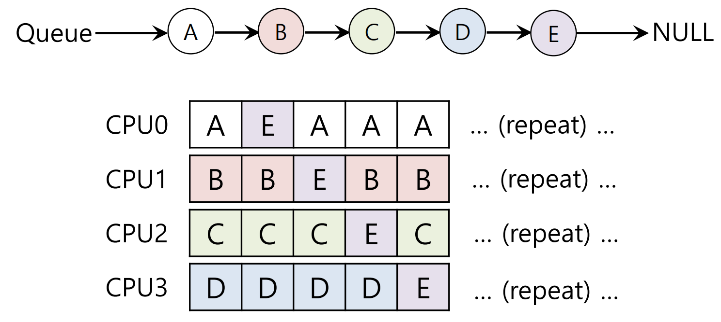
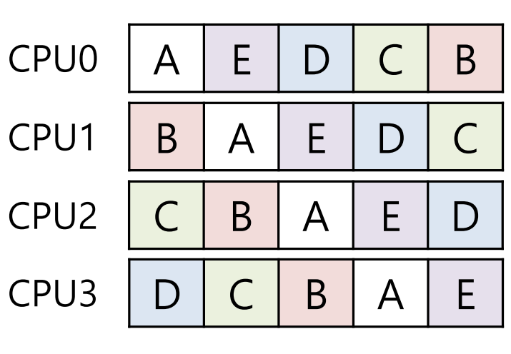
Multiprocessor Scheduling
Symmetric Multiprocessing
(a). SM with cache affinity
(b). Preserving affinity for most
University of Applied Sciences Hamm-Lippstadt
29.07.24 < <number> >

Slide 4
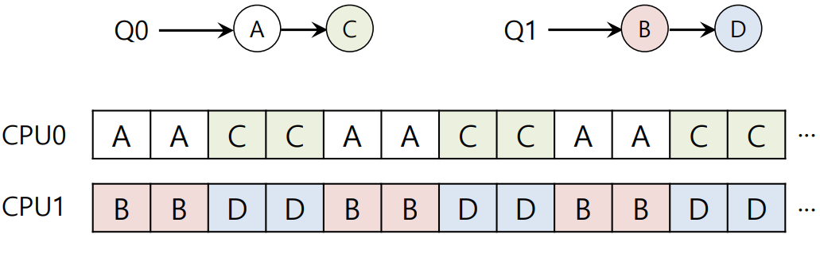
Multiprocessor Scheduling
Asymmetric Multiprocessing
University of Applied Sciences Hamm-Lippstadt
29.07.24 < <number> >

Slide 5
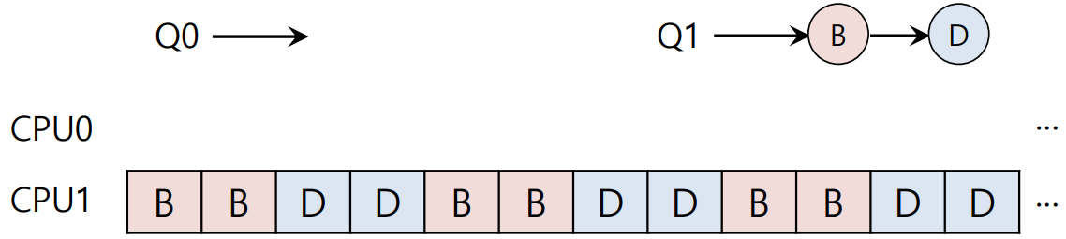
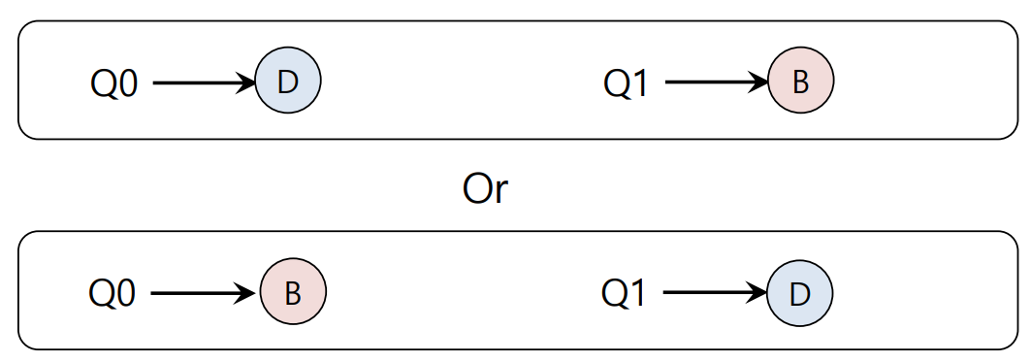
Multiprocessor Scheduling
Load Balancing
University of Applied Sciences Hamm-Lippstadt
29.07.24 < <number> >

Slide 6
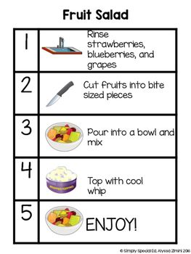
HU’s Algorithm
Task dependencies
Divided into multiple sub tasks.
Recipe that has to be cocked to maintain an order
The optimal
Reduce the total time needed
University of Applied Sciences Hamm-Lippstadt
29.07.24 < <number> >

Slide 7
HU’s Algorithmic Steps
Physical Internet Scenario
City | Hub | Hub dependency
A | H1 | A, B
B | H2 | B, C
C | H3 | A, C
University of Applied Sciences Hamm-Lippstadt
29.07.24 < <number> >

Slide 8
HU’s Algorithmic Steps
Task Graph & Assign Priorities
H1
H2
50
50
50
50
A
B
C
70
70
90
90
H3
University of Applied Sciences Hamm-Lippstadt
29.07.24 < <number> >

Slide 9
HU’s Algorithmic Steps
B
C
H1
H2
H2
H3
Priority
Execution Time
A
B
C
A
H1
H3
A
University of Applied Sciences Hamm-Lippstadt
29.07.24 < <number> >

Slide 10
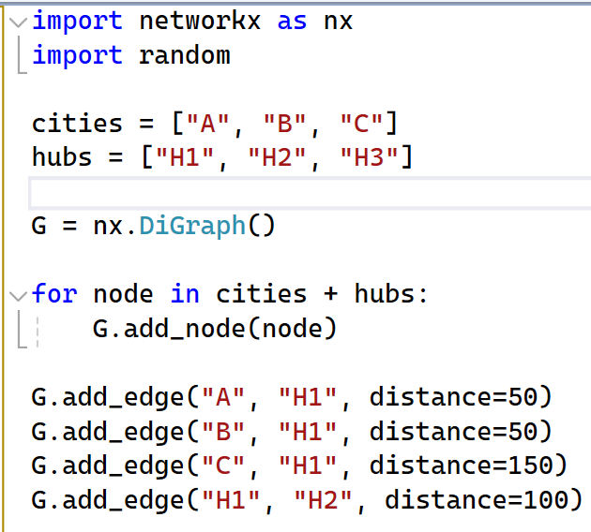
Python Implementation
First Step
University of Applied Sciences Hamm-Lippstadt
29.07.24 < <number> >

Slide 11
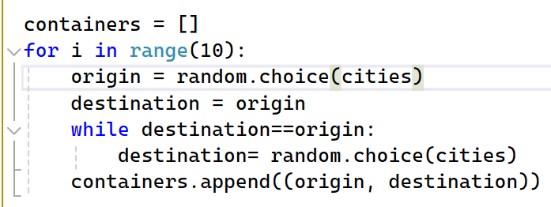
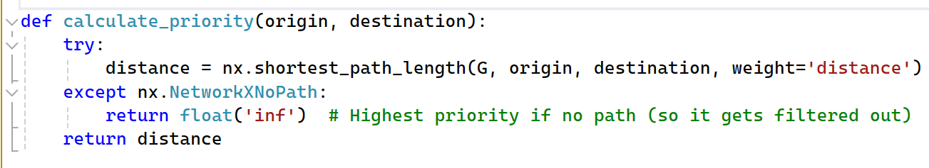
Python Implementation
2. Second Step
University of Applied Sciences Hamm-Lippstadt
29.07.24 < <number> >

Slide 12
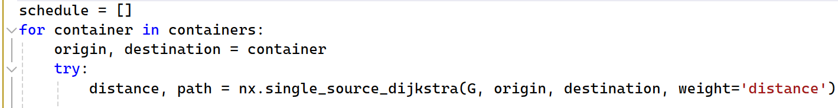
Python Implementation
3. Third Step
University of Applied Sciences Hamm-Lippstadt
06.02.24 < <number> >

Slide 13
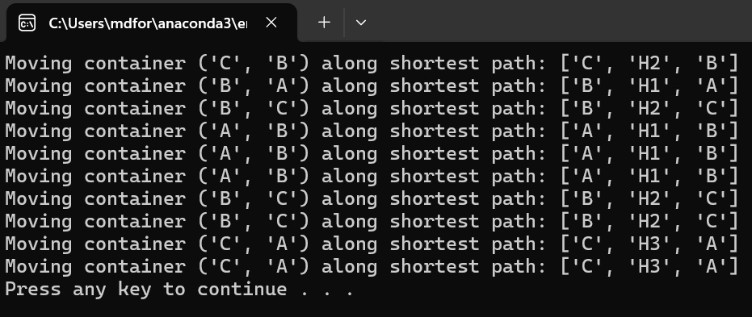
Python Implementation
Result
University of Applied Sciences Hamm-Lippstadt
29.07.24 < <number> >

